Slide 1
MOTOR HEALTH PREDICTION
By Team Codex
Deevi Sai Surya Chandra Bharath
Adapa V Krishna Raghavendra
Avinash Sangula
Dasari Vishnu Vardhan

Slide 2
INTRODUCTION
Motors are commonly used in both industrial applications and household appliances.
Motors will play an important role in both house hold and industrial and also in agriculture sector.
Motors will pump the water from one place to another place this pumping of water by motors will depends on particular parameters which will describes the performance of Water motor. Capacity, voltage, Current, Rotational speed and temperature are the some examples of parameters which will predict the performance of Water Motor. All the above parameters are independent and the performance which is depends on the independent variables .

Slide 3
Uses of Motor
In many thermal power stations , the electric motors are used to pump the water and converts to steam within turbines to generate the electric power. By our project we can check the performance of the motor and we can know the status of the motor (i.e., whether the motor is good or bad).
In our country the agriculture is one of the important sector in which the farmers are used the motors to flow the water throughout the land. Randomly by the usage of the motor there may be a chance to get problems in motor such that to overcome from that problems it is better to know the performance of the motor thereby if the performance is bad we can replace the motor and then continues the flowing of water .
In some areas , due to some digging and irrigation problems our government is used to send the water through underground pipes which is connected to the motor at other place. At these circumstances , it is better to know the performance of the motor frequently.
In the houses, streets there are many motors which is used daily for household purposes . By knowing the performance of the motor , we can overcome the problems which comes when the motor is failure.

Slide 4
Problem statement
In our project we will predict the performance of the water motor by comprising the parameters like capacity, voltage, Current, Flow rate, Rotational Speed with some ranges. If the performance of the motor is good then we will represent with 1 else represents with 0.

Slide 5
Problem solution
The performance of the Motor is obtained by the parameters like capacity, voltage, Current, Flow rate , temperature, Speed, capacity in watts with some ranges.
If the performance of the motor is good then we will represent with 1 else represents with 0.
In many industries , there was a problem that if the electric motor functionality is not good the production can be reduced or delayed.
Therefore, by knowing the performance of the motor , we can replace the motor if the performance results bad else we continue with production.

Slide 6
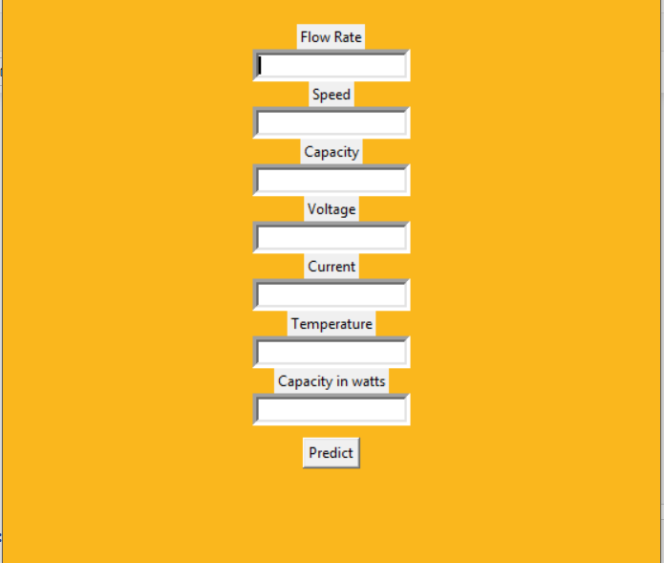
User Interface

Slide 7
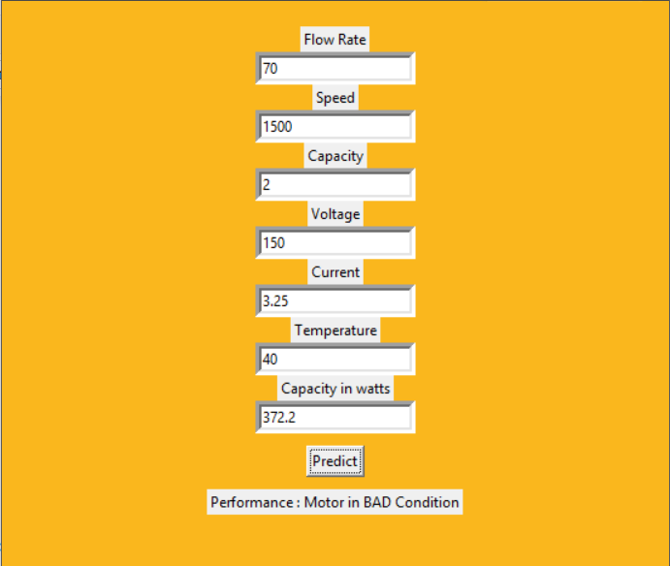
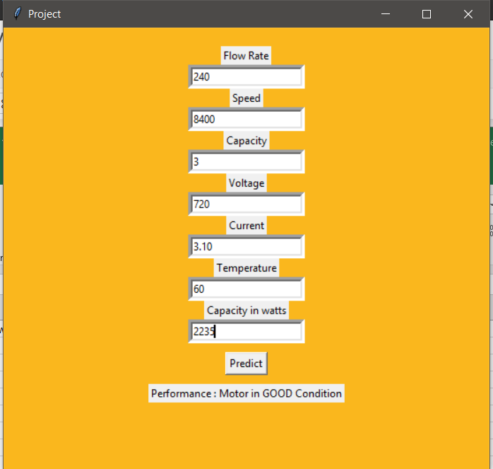
Prediction of Motor Health
Bad Condition
Good condition

Slide 8
CONCLUSION
We conclude the performance of the motor by using the ANN methodology which comprise the seven parameters . If the performance is good , we can continue the production . If the performance is bad , it is better to change the motor to get the production within the desired time.
We suggest to implement our project in agricultural areas , industrial purposes and various platforms such that we can reduces the future problems and also can produce the production in time. We should always shield the motor from external vibrations , particularly when they are not working.

